Slide 1
React & Redux
Keep your head cool and focused, there’s a tons of stuff to see today
Cedric Hartland

Slide 2
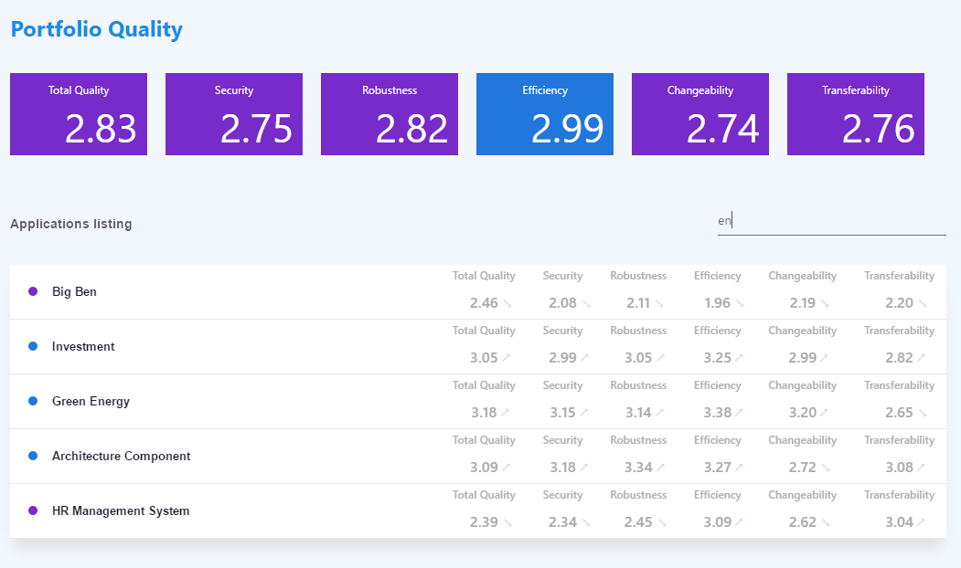
A project we’re targeting

Slide 3
React – a gentle introduction
Javascript library for building user interfaces

Slide 4
React – a library that defines views through components
In a declarative way
Given an application state, renders some shadow DOM such inputs are named properties
Optimized rendering engine inspired from game engines
Little assumption on application structure can “easily” integrate with other technologies
Can render on server side SEO please

Slide 5
React – what’s actually good in it ?
There are a few good parts
Components
Enhanced reusability well, keep it generic if you plan on reusing…
Rendering lifecycle with optimizations
Basic type checking
Becomes powerful with ES6 and more
Dependency management
Uptaded syntax and language features
Css inclusions
Arguably JSX
As opposed to string based templates

Slide 6
A simple view
class Tile extends React.Component {
static propTypes = {
value: React.PropTypes.number,
title: React.PropTypes.string
};
render() {
return ( <div className="tile">
<div className="tile-header">{this.props.title}</div>
<div className="tile-value">{numeral(this.props.value).format('0.00')}</div>
</div>
);
}
}
Reusable class or function
Properties types
JSX declarations

Slide 7
Adding user interactions
class Filter extends React.Component {
…
render() {
return (
<div className="filter-input">
<input
type="text"
value={this.props.filterText}
placeholder={this.props.placeholder}
onChange={this.props.handleFilter}
/>
</div>);
}
}
Bind functions to events

Slide 8
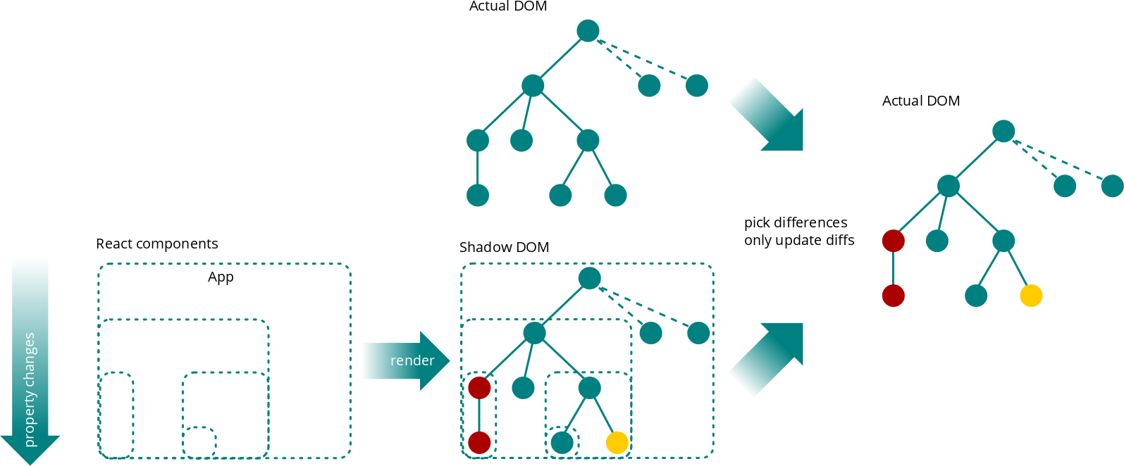
Rendering workflow

Slide 9
Redux, a sweet introduction
Single source of truth, read-only state, pure functions

Slide 11
React & Redux
Rock & Roll

Slide 12
Wait, there’s more
Build, enhanced development process and how to test

